Slide 1
Arduino Workshop #8
Interfacing with liquid crystal displays

Slide 2
PowerPoint and Code
Github.com/EELabMan
Go To Repositories and find Arduino 8 LCD

Slide 3
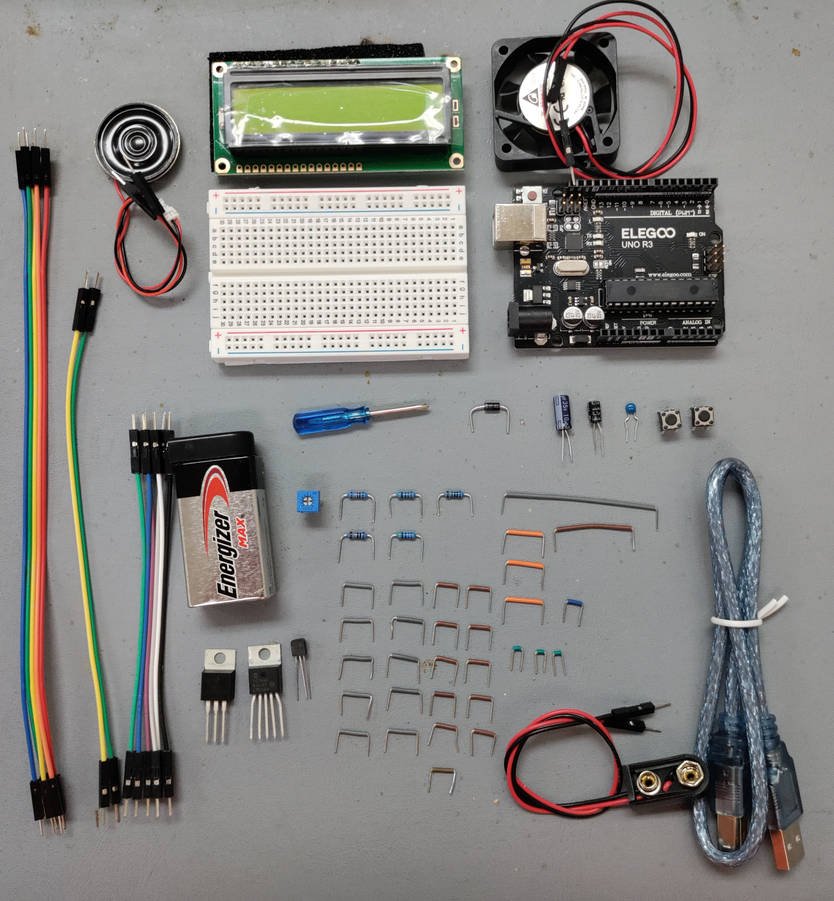
Parts
LCD
DC Fan
Speaker
2x Breadboard
Male to Male Jumpers:
6 short
2 medium
5 long
Arduino Uno
Screwdriver
2x push buttons
4001
Diode
Breadboard wires:
3-green .1”
1- blue .2”
11- brown .3”
10- grey .4”
3- orange .5”
1- brown 1”
1- grey 2.1”
2-
10kΩ
2-
4.7kΩ
1kΩ
0.1uF
Cap
9V battery with
protective cap
Pot
10uF
Cap
1uF
Cap
2222
USB Cable
5V
Reg-
ulator
TC74
Temp
sensor
9V battery clip

Slide 4
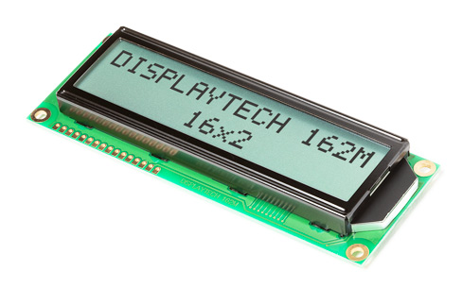
Setting up the LCD
We will be using pre soldered 16x2 LCDS
If after this workshop, you choose to purchase a LCD for a project, know that some come w/o the headers soldered on and may have different pinouts.
16x2 refers to the number of columns and rows the LCD displays
16 columns
2 rows

Slide 5
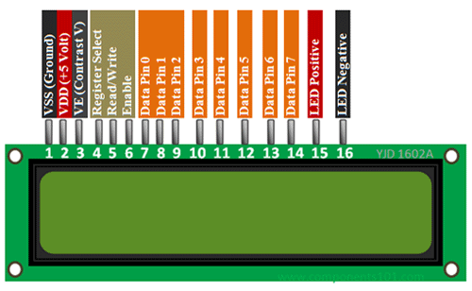
Breaking down the pins
Pin 1 Ground : Pin 2 Power ( +5V )Pin 3 (contrast) - controls how dark the display is. It connects to the center pin of our POT
Pin 4 (RS) - sets the LCD to command or character mode
Based on its state the LCD is either interpreting data as a command or a character
Pin 5 (RW) - tied to ground
indicating we will only ever be writing to the LCD not reading from it
Pin 6 (EN) - used to tell the LCD when data is ready
Pins 7 to 14 - used to transmitting data
Usually labeled D0 to D7 (in order)
pins 7 to 10 (D0 - D3) will be unused by us
Pin 15 and 16 - run the back light
Connect them to 5v (pin 15) and ground (pin 16) with a current limiting resistor as needed

Slide 6
Connecting to the arduino
You can connect the communication pins on the LCD to any I/O pins on the arduino. We will use the following pins for our software and hardware setup. See next slide for the breadboard layout.
LCD Pin | Arduino Pin
RS | Pin 2
EN | Pin 3
D4 | Pin 4
D5 | Pin 5
D6 | Pin 6
D7 | Pin 7

Slide 7
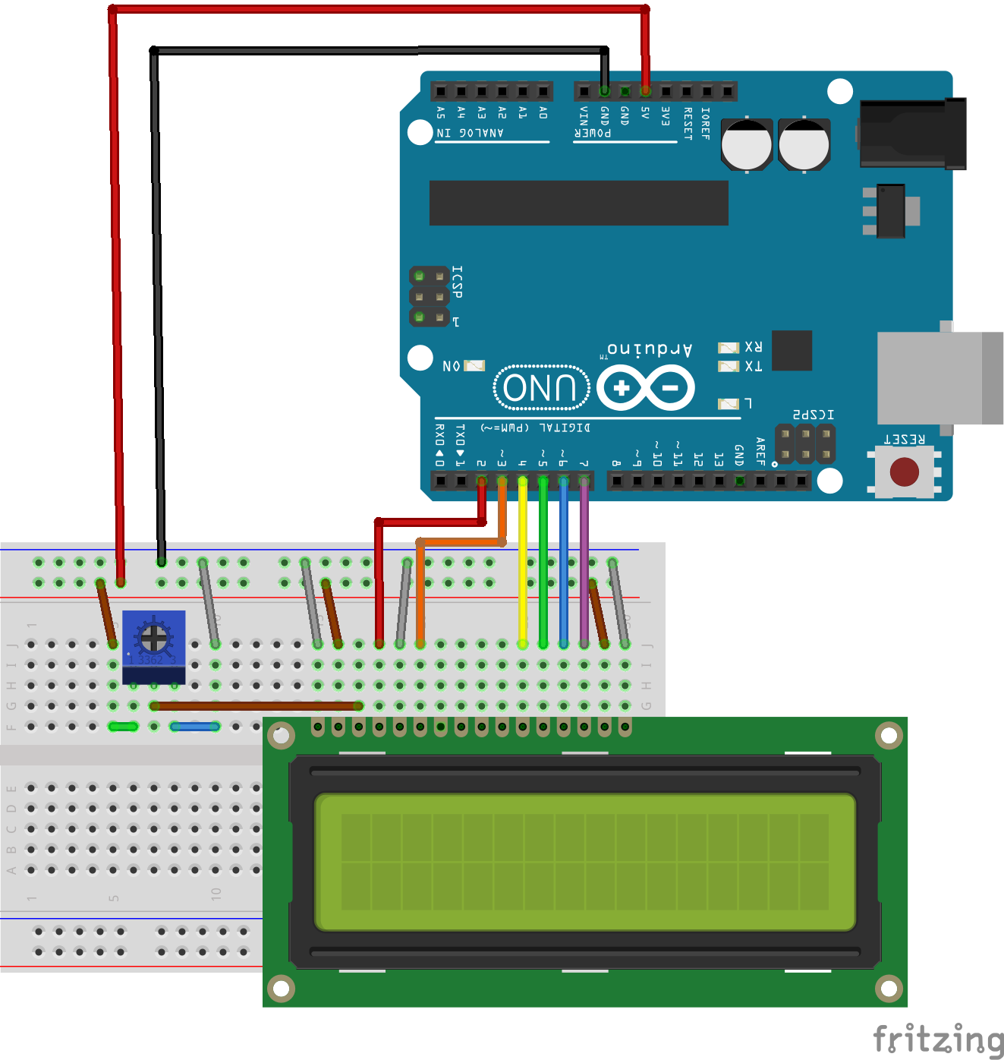
Lets wire up the LCD
Again, The breadboard wires are colored correctly, and the male-to-male jumpers can be any color.

Slide 8
Using the LiquidCrystal Library
The Arduino IDE includes the LiquidCrystal library
It includes simplified functions to
Blinking the cursor
Automatically scrolling text
Creating custom characters
Changing direction of printing
Many other useful additions and functions
Under the hood:
You can find a description of the library function ( and other functions) as well as examples of use at
http://arduino.cc/en/Reference/LiquidCrystal

Slide 9
Adding text to the display
The first thing we will be doing in order to learn the basic operation of the LCD is to add text and an incrementing number to the display
To initialise the LCD we use the following code
#include <LiquidCrystal.h>
Initiallizes the liquid crystal library
LiquidCrystal lcd (2,3,4,5,6,7);
This creates a liquid crystal object named lcd and the arguments represent the pins connected (RS,EN,D4,D5,D6,D7 in that order)
lcd.begin(16,2);
This sets the LCD display character size as a number of rows and columns respectively
lcd.setCursor(0,1);
This moves the cursor to a specific spot
Columns and rows are indexed (0,0) in the top-left
lcd.print(“UTA EE LABS!”);
This will print what ever characters you supply (as a char and that will fit in the dimensions of the LCD)

Slide 10
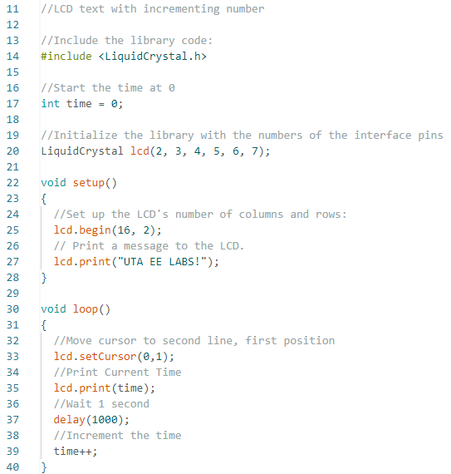
Adding it all to a sketch
Upload LCD_text.ino to the arduino.
You probably will not see anything yet.
You will need to adjust the potentiometer with the very small screwdriver to adjust the screen.
You should see your message with a counter increasing every second

Slide 11
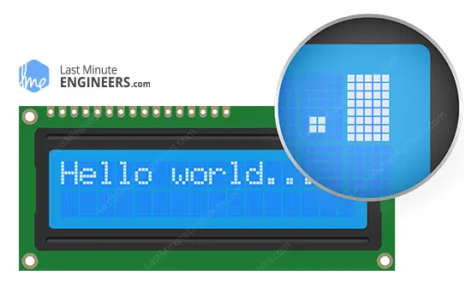
Creating Special Characters or Animations
If you want special characters like a degree's sign or greek letters - the LiquidCrystal library supports the definition of custom Characters
To create a custom character
You will notice each character block is really made up of a 5x8 grid of pixels
You simply define the value of each of these pixels and send that information to the display

Slide 12

Demonstration of this concept
We will make a series of characters that will fill the second row of the display with an animated progress bar
Each space is 5 pixels wide
So there will be 5 custom characters
1st column filled
1st & 2nd col filled
Etc.
We will use binary to encode the state of the pixel (1 is on 0 is off)

Slide 13
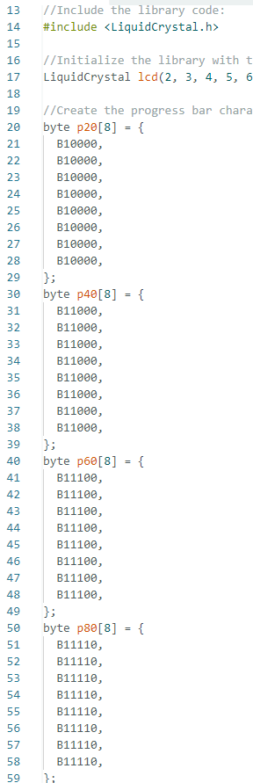
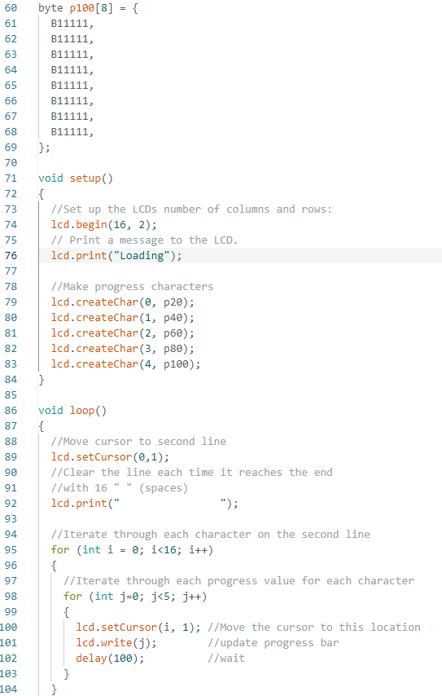
Defining your special characters
Upload LCD_progress_bar.ino to the Uno.
p20 through p100 give the binary for the 5x8 block we will need.
lcd.createChar names p20 –p100 to zero to 4.
Try to understand the embedded for loops. They use I and J to create the animation.

Slide 14
Building a personal thermostat

Slide 15
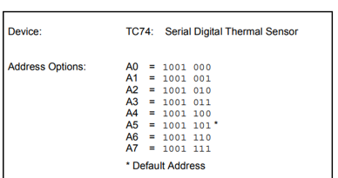
Items we will use
A DC fan
Wired with a voltage regulator, transistor and a 9 volt battery (like Arduino 3 workshop)
Two buttons with 10 ㏀ pull - down resistors : For Tempurature control
A speaker
Connected to an I/O pin
I²C temperature sensor
Hooked up exactly as we learned in Arduino 6
We will add another breadboard to fit all the aditional components.
If the display works but does not show a tempurature – Check you have the right addess to the TC74 digital tempurature sensor.

Slide 16
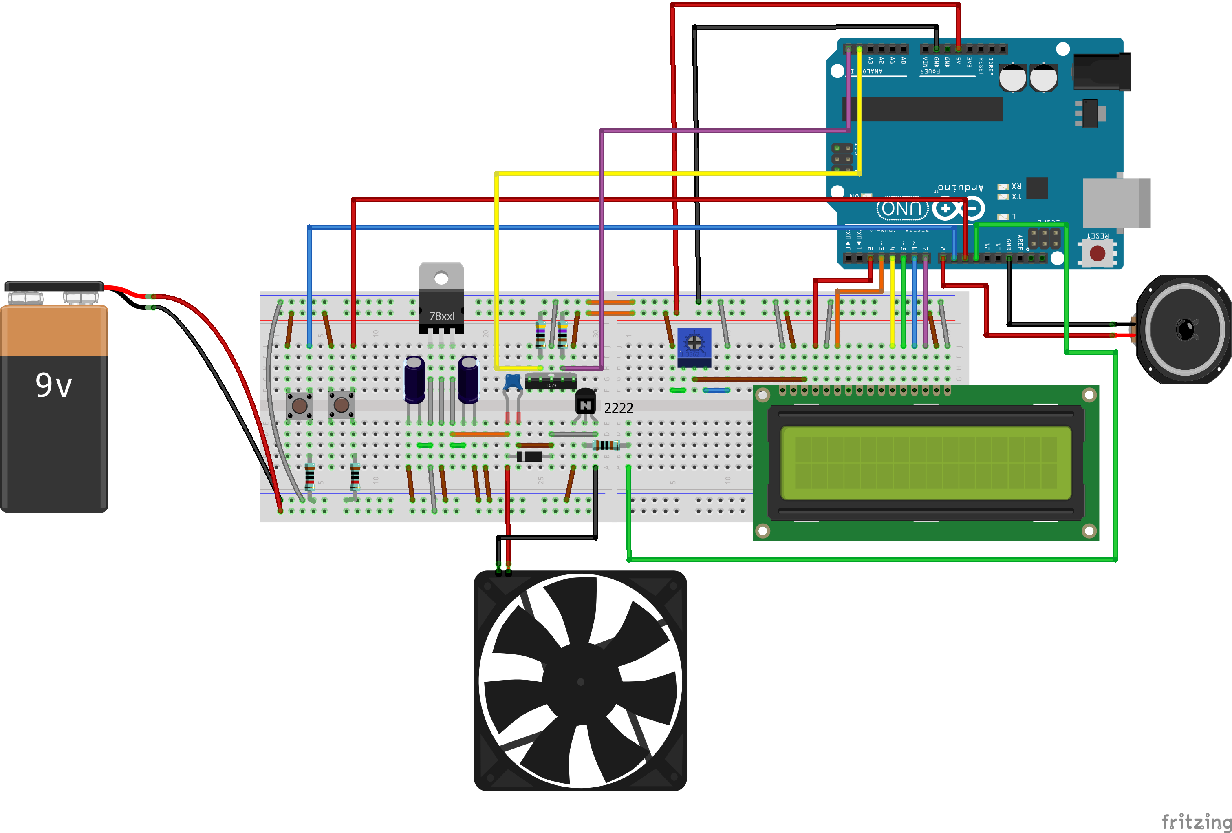
Layout:
Take your time and make sure everything is in the correct row and column.
Notice the cathode (-) on the electrolytic caps are on the outside.
10 uF
0.1 uF
1 uF
TC74
Photo on next slide

Slide 17
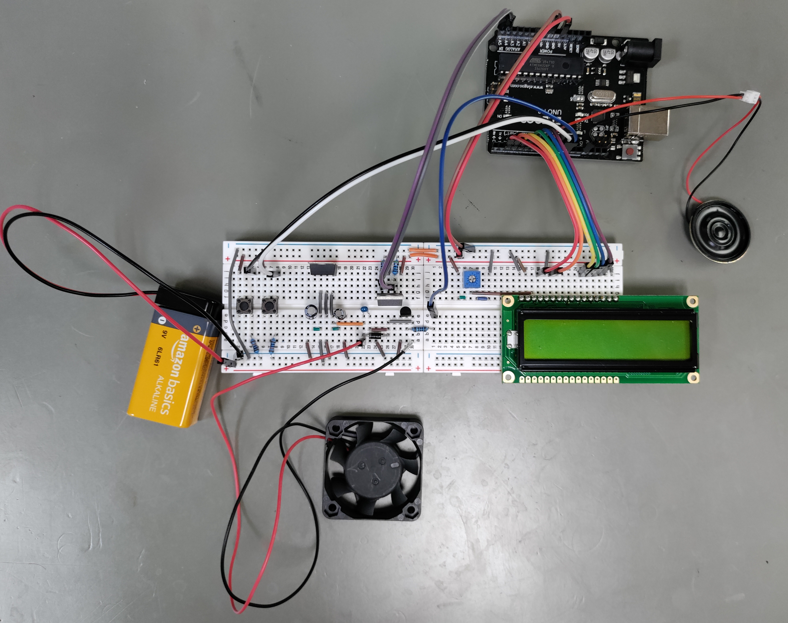

Slide 18
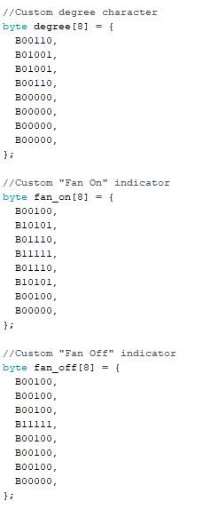
The custom characters
You can see the degree sign in the binary matrix!
This “fan” looking sign indicates the fan is on
This + sign indicates the fan is off

Slide 19
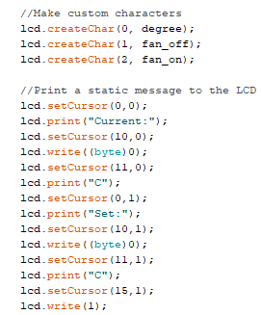
We will utilize the custom charachters and refresh the screen as shown
(byte) 0 is the degree sign

Slide 20
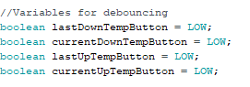
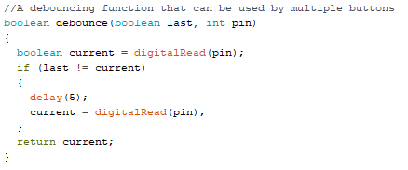
Adjusting the set point with buttons

Slide 21
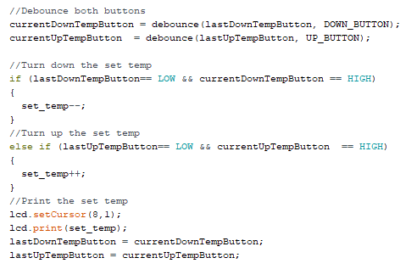
Updating the LCD
This code
first runs the debounce() function for each button and then adjusts the set temp variable if one button is pressed
Updates the LCD and button states

Slide 22
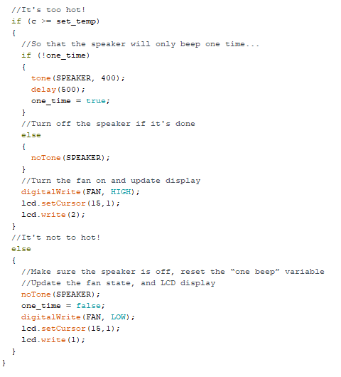
Adding audio warning and fan
Here we see
tone()
Paired to a delay() and notone() command
Using a state variable we determine if the speaker has beeped
And don't let it beep again until after the temp dips (and the state variable is reset)
When the fan turns on and indicator on the LCD changes

Slide 23
Bring it all together
You should now have a fully functioning project (combining all the snippets from earlier to all work together to produce the desired result)
Once you load the code onto the arduino you no longer need to have it connected to a computer to run, you could take it and place it anywhere in the room to tell you the temperature (as long as you can connect it to a plug (or battery))

Slide 24
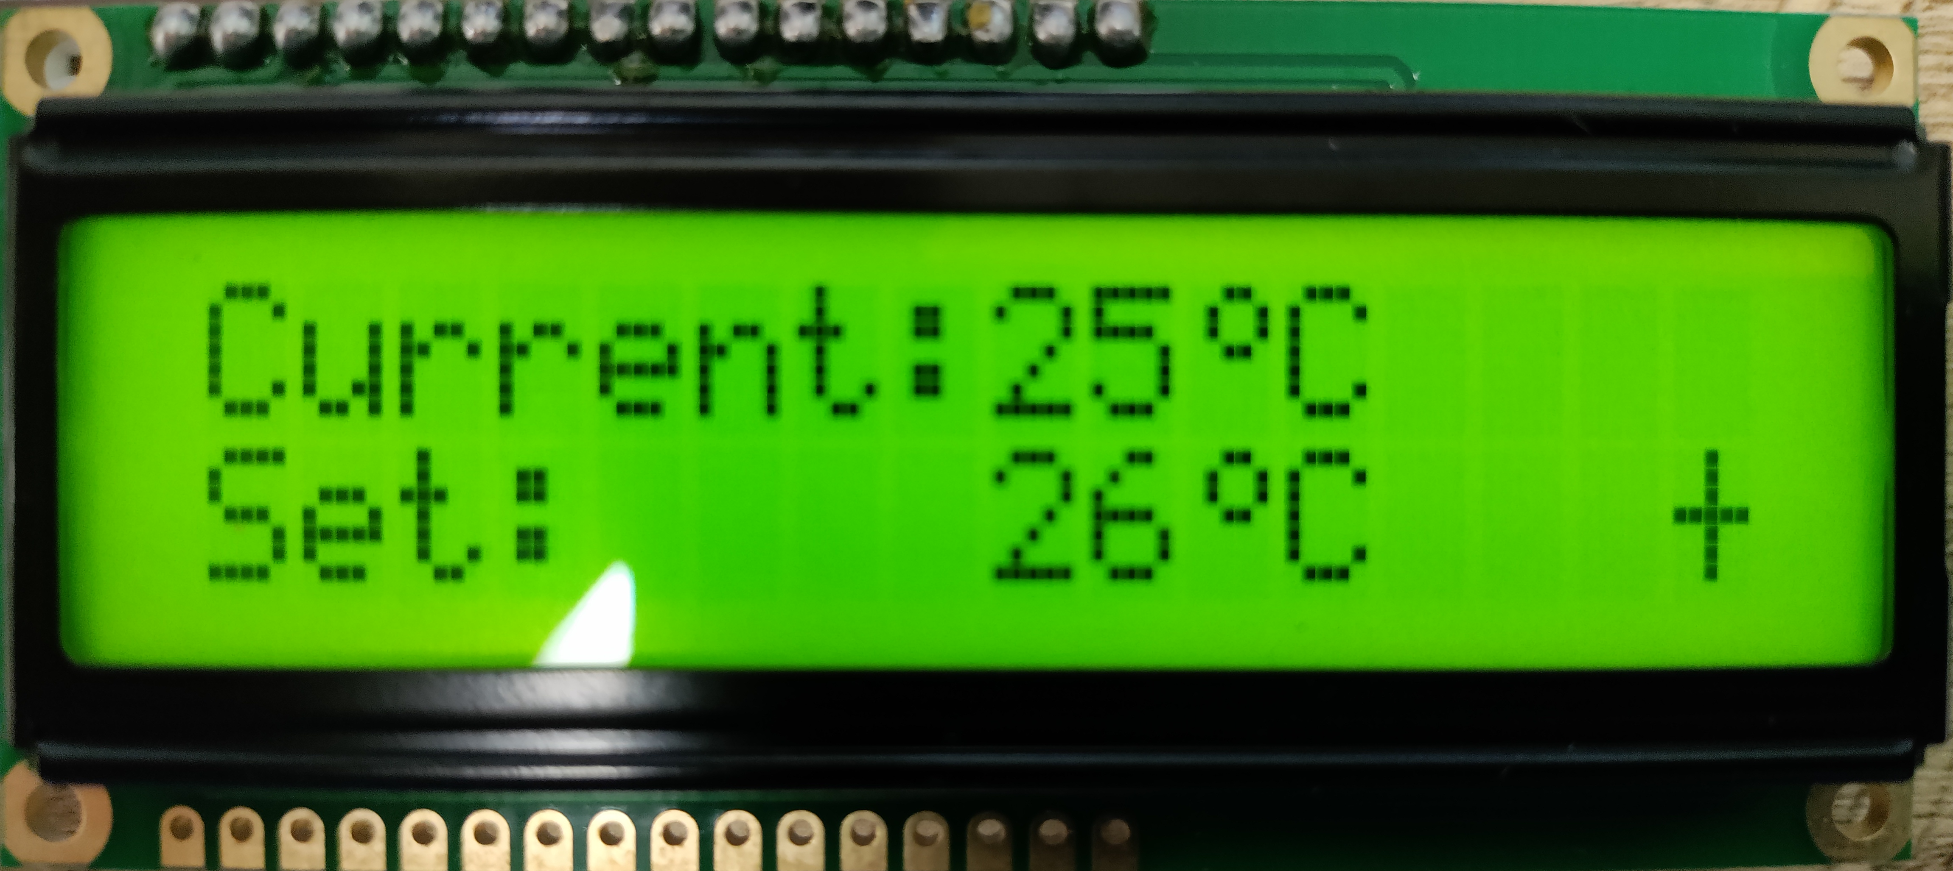
The LCD should look similar to this

Slide 25
Dissassemble to project
Please put the protective cap back on the 9V battery
Remove all the parts from the breadboard and Arduino and place them in the bag – Small parts go in the small bag.
Return the project to the lab manager.

Slide 26
Stay tuned
Arduino 9 will cover how to send and receive data using Bluetooth.
We’ll also connect to our smart phones and control some LED’s!

